Slide 1
Intermediate Coding Week 24
Graphics and Swing

Slide 2
Graphics methods
Method name | Description
g.drawLine(x1, y1, x2, y2); | line between points (x1, y1), (x2, y2)
g.drawOval(x, y, width, height); | outline largest oval that fits in a box of size width * height with top-left at (x, y)
g.drawRect(x, y, width, height); | outline of rectangle of size width * height with top-left at (x, y)
g.drawString(text, x, y); | text with bottom-left at (x, y)
g.fillOval(x, y, width, height); | fill largest oval that fits in a box of size width * height with top-left at (x, y)
g.fillRect(x, y, width, height); | fill rectangle of size width * height with top-left at (x, y)
g.setColor(Color); | set Graphics to paint any following shapes in the given color

Slide 3
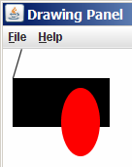
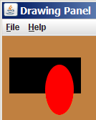
Using colors
Pass a Color to Graphics object's setColor method
Subsequent shapes will be drawn in the new color.
g.setColor(Color.BLACK);
g.fillRect(10, 30, 100, 50);
g.drawLine(20, 0, 10, 30);
g.setColor(Color.RED);
g.fillOval(60, 40, 40, 70);
Pass a color to DrawingPanel's setBackground method
The overall window background color will change.
Color brown = new Color(192, 128, 64);
panel.setBackground(brown);

Slide 4
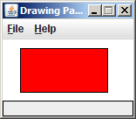
Outlined shapes
To draw a colored shape with an outline, first fill it, then draw the same shape in the outline color.
// inner red fill
g.setColor(Color.RED);
g.fillRect(20, 10, 100, 50);
// black outline
g.setColor(Color.BLACK);
g.drawRect(20, 10, 100, 50);

Slide 5
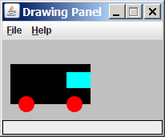
Superimposing shapes
When ≥ 2 shapes occupy the same pixels, the last drawn "wins."
g.setColor(Color.BLACK);
g.fillRect(10, 30, 100, 50);
g.setColor(Color.RED);
g.fillOval(20, 70, 20, 20);
g.fillOval(80, 70, 20, 20);
g.setColor(Color.CYAN);
g.fillRect(80, 40, 30, 20);

Slide 6
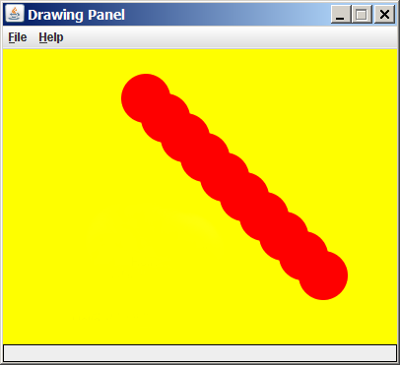
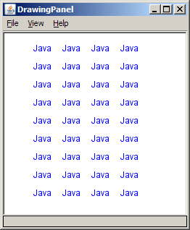
Drawing with loops
The x,y,w,h expressions can use the loop counter variable:
g.setColor(Color.RED);
for (int i = 1; i <= 10; i++) {
// x y w h
g.fillOval(100 + 20 * i, 5 + 20 * i, 50, 50);
}
Nested loops can be used with graphics:
g.setColor(Color.BLUE);
for (int x = 1; x <= 4; x++) {
for (int y = 1; y <= 9; y++) {
g.drawString("Java", x * 40, y * 25);
}
}

Slide 7
Ball and Paddle tutorial
http://www.edu4java.com/en/game/game0-en.html

Slide 8
Poll
https://forms.gle/65uCT4obRrNQVLqHA

Slide 9

Problems

Slide 10
Question 1
Try creating your own program using what you now know about Graphics and Swing!

